Slide 1
Measurement of Radiative Non-equilibrium for Air Shocks Between 7-9 km/s
Brett A. Cruden
Aaron M. Brandis
AMA Inc at NASA Ames
Radiation in High Temperature Gases Workshop
Stuttgart, Germany
Nov. 22, 2016

Slide 2
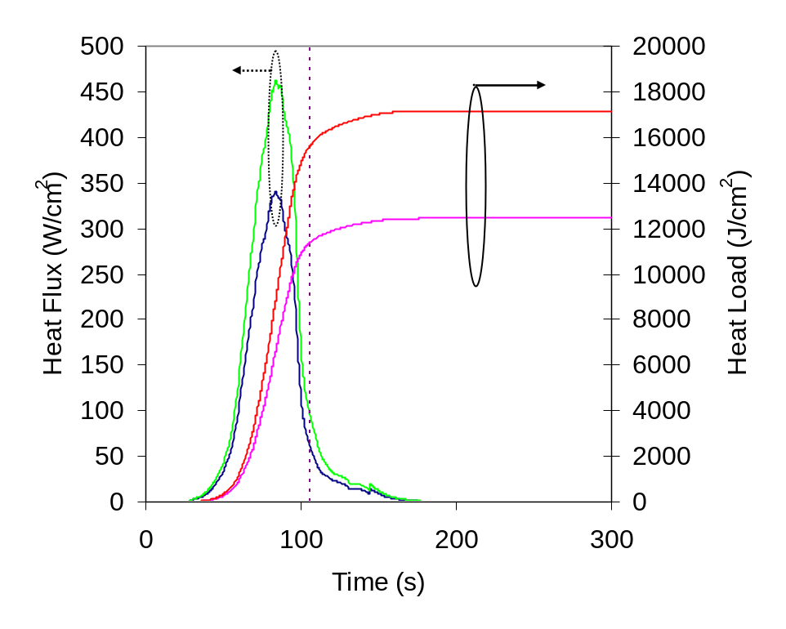
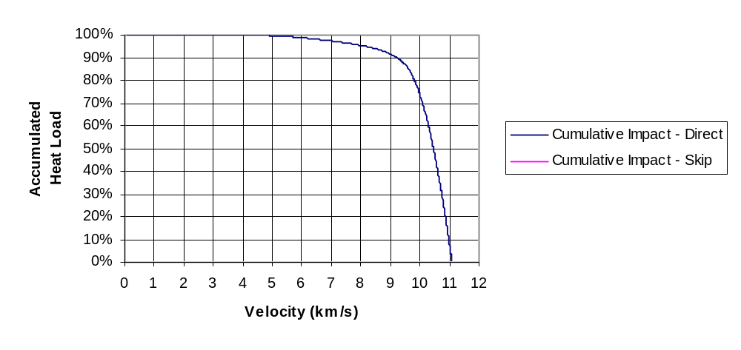
Motivation
About 8% of Lunar Return radiative heating occurs below 9 km/s
Return from lower altitude (e.g. EFT1) is entirely in this speed regime
Radiation phenomena not well validated in this speed regime

Slide 3
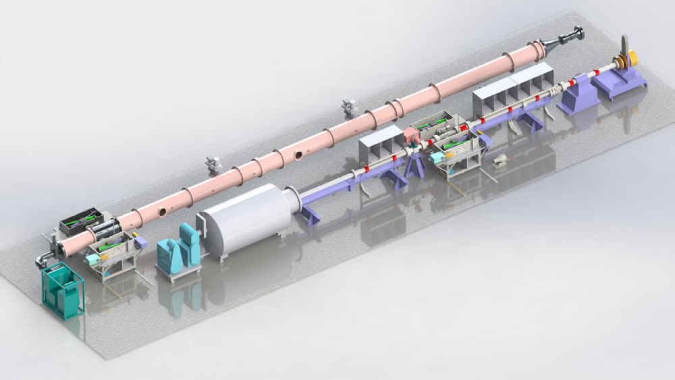
Approach
Radiation is measured in EAST Facility
  24” Diameter tubes for low (<0.1 Torr) pressure
  4” Diameter tube for higher (>0.1 Torr) pressure
Measurement by between 2-4 spectrometers covering 190-1450 nm

Slide 4
Conditions Measured
51 shots between 7-9 km/s
  33 (27 good) on the 24” Tube (0.01, 0.05, 0.14 Torr)
    15 from 190-500 nm
    12 from 500-1450 nm
  18 (17 good) on the 4” Tube (0.14, 0.30, 0.50, 0.70 Torr)
    All from 190-1450 nm
Subset of 10 tests selected for further analysis (1 per pressure/wavelength/tube diameter combination):
Shot No | Velocity (km/s) | Pressure (torr) | Range (nm) | Tube Diameter (cm)
15 | 8.18 | 0.01 | 190-500 | 60.33
32 | 8.57 | 0.01 | 500-1450 | 60.33
8 | 8.62 | 0.05 | 190-500 | 60.33
24 | 8.87 | 0.05 | 500-1450 | 60.33
20 | 8.29 | 0.14 | 190-500 | 60.33
22 | 8.36 | 0.14 | 500-1450 | 60.33
38 | 8.33 | 0.14 | 190-1450 | 10.16
42 | 8.09 | 0.3 | 190-1450 | 10.16
46 | 7.71 | 0.5 | 190-1450 | 10.16
50 | 7.34 | 0.7 | 190-1450 | 10.16

Slide 5
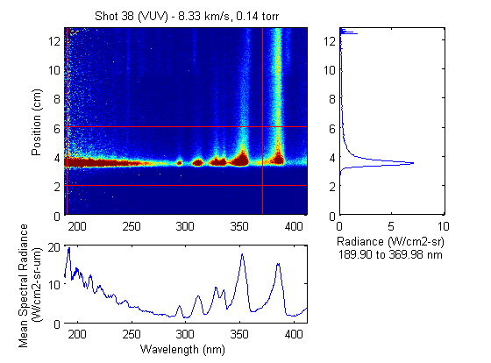
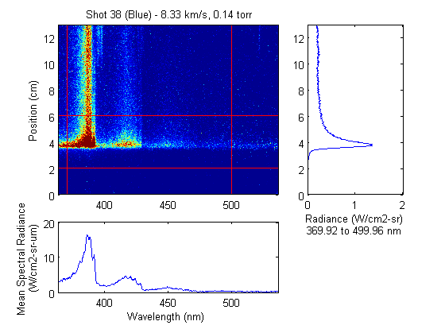
Sample Data (190-500 nm)
Spectra are resolved in wavelength and position behind shock

Slide 6
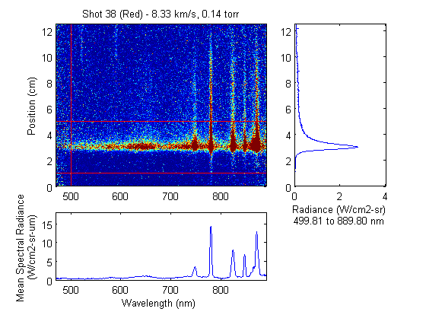
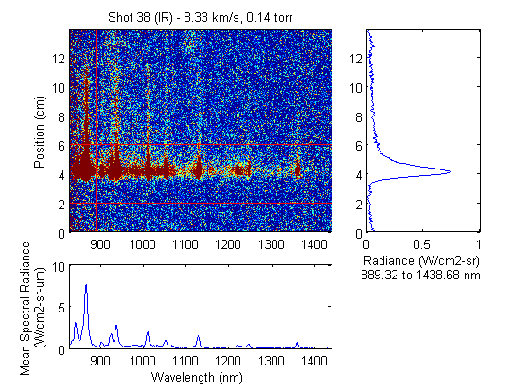
Sample Data (500-1450 nm)
Spectra are resolved in wavelength and position behind shock

Slide 7
Non-equilibrium Analysis
Contact Front
2 cm
2 cm
Non-equilibrium
Zone
(somewhat) arbitrarily assign ±2 cm of peak as “non-equilibrium zone”
Integral of this, divided by tube diameter, is the “non-equilibrium metric”
Presented as function of wavelength : “spectral non-equilibrium metric”

Slide 8
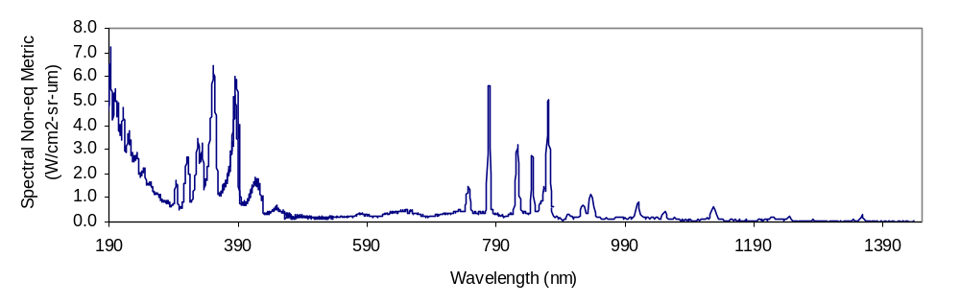
Spectral Non-equilibrium Metric
UV Camera
UV/Vis
NIR Camera
Vis/NIR
Non-equilibrium metric composite from 4 different spectrometers
Spectral Non-equilibrium Metric has units of radiance
  It is equal to the radiance accumulated through the non-equilibrium zone if the non-equilibrium region is optically thin

Slide 9
Spectral Non-equilibrium Metric
190-500 nm
NO, N₂, N₂⁺
500-890nm
N₂, N, O (3p-3s)
900-1450nm
N, O (3d-3s)
Identification of features suggests regions for further analysis

Slide 10
Analysis Methods
DPLR/NEQAIR are used to produce 1D (stag. line) profiles for comparison to shock tube data
Variation on modeling options:
  Two-temperature model
    Traditionally, DPLR used T_{e}=T_{t}, which is inconsistent with radiation calculation
    More common practice, now available in DPLR, is to use T_{e}=T_{v}
  Reaction rates
    Park90 is considered “heritage”
    Park93 updates some key rates
    Johnston has updated chemistry, last published in 2014
  Electron impact excitation
    NEQAIR still uses rates from Park90 (possibly unpublished modifications)
    Huo recently computed new rates for excitation (N only here)
Combined makes 3 x 2 x 2 = 12 combinations
  Will focus on:
    Park90 with Te=Tt (Heritage)
    Park93 and Johnston with Te=Tv
    Huo vs Park excitation and Boltzmann distributions for selected comparisons

Slide 11
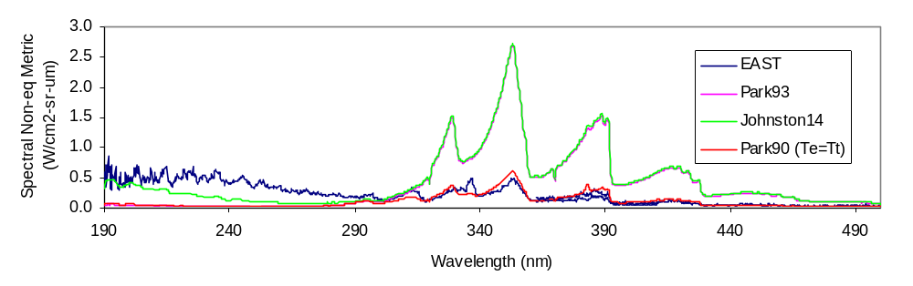
Non-equilibrium – 190-500 nm (0.01 Torr, 8.2 km/s)
60 cm tube
N₂⁺ 1st Negative
(B²Σ⁺_{u}→X²Σ⁺_{g})
N₂ 2nd Positive
(C³Π→B³Π)
NO
All models underpredict NO
N₂⁺ overpredicted by T_{e}=T_{v} options, Heritage does ok
N₂ 2nd Positive underpredicted

Slide 12
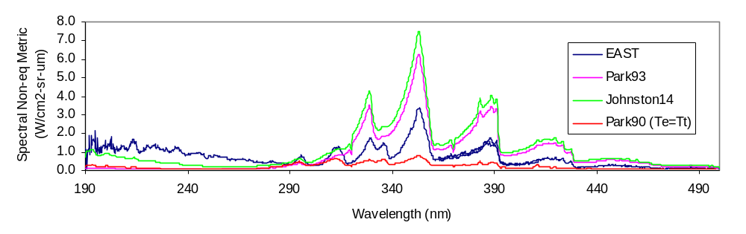
Non-equilibrium – 190-500 nm (0.05 Torr, 8.6 km/s)
60 cm tube
N₂⁺ 1st Negative
(B²Σ⁺_{u}→X²Σ⁺_{g})
N₂ 2nd Positive
(C³Π→B³Π)
NO
NO still underpredicted
N₂⁺ improving for T_{e}=T_{v} options, Heritage now too low
N₂ 2nd Positive still underpredicted

Slide 13
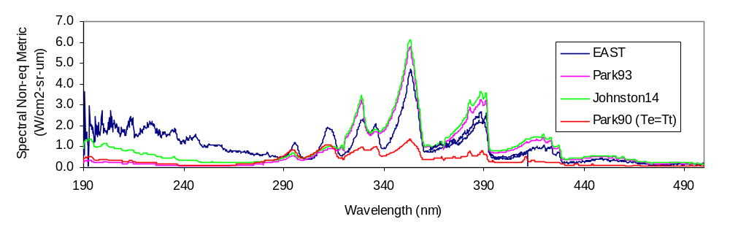
Non-equilibrium – 190-500 nm (0.14 Torr, 8.3 km/s)
60 cm tube
N₂⁺ 1st Negative
(B²Σ⁺_{u}→X²Σ⁺_{g})
N₂ 2nd Positive
(C³Π→B³Π)
NO
NO still underpredicted
N₂⁺ slightly over for T_{e}=T_{v} options, Heritage underpredicts
N₂ 2nd Positive underpredicted

Slide 14
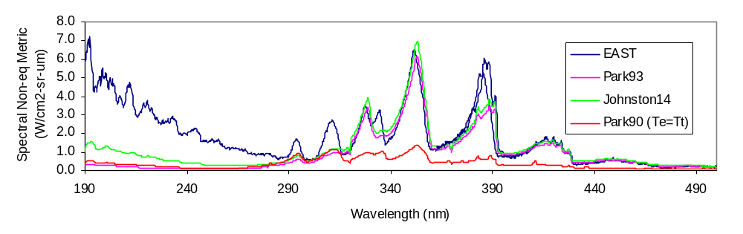
Non-equilibrium – 190-500 nm (0.14 Torr, 8.3 km/s)
10 cm tube
N₂⁺ 1st Negative
(B²Σ⁺_{u}→X²Σ⁺_{g})
N₂ 2nd Positive
(C³Π→B³Π)
NO
NO underpredicted
N₂⁺ matched for T_{e}=T_{v} options, Heritage underpredicts
  CN contamination accounts for disagreement at 388 nm
N₂ 2nd Positive underpredicted

Slide 15
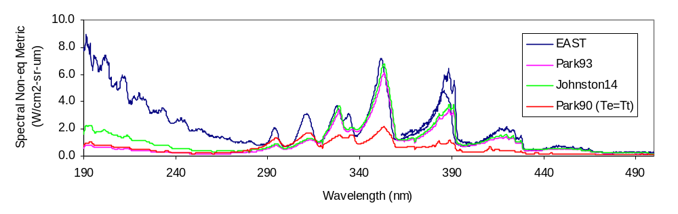
Non-equilibrium – 190-500 nm (0.30 Torr, 8.1 km/s)
10 cm tube
N₂⁺ 1st Negative
(B²Σ⁺_{u}→X²Σ⁺_{g})
N₂ 2nd Positive
(C³Π→B³Π)
NO
NO underpredicted
N₂⁺ matched for T_{e}=T_{v} options, Heritage underpredicts
  CN contamination accounts for disagreement at 388 nm
N₂ 2nd Positive underpredicted

Slide 16
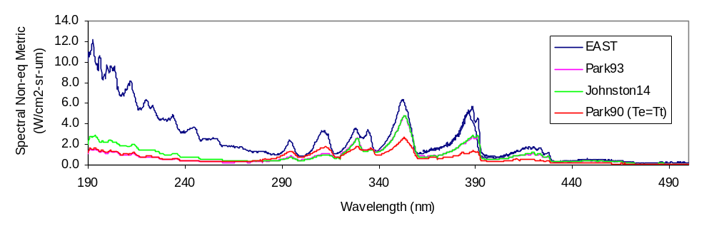
Non-equilibrium – 190-500 nm (0.50 Torr, 7.7 km/s)
10 cm tube
N₂⁺ 1st Negative
(B²Σ⁺_{u}→X²Σ⁺_{g})
N₂ 2nd Positive
(C³Π→B³Π)
NO
NO still underpredicted
N₂⁺ being underpredicted
  Worse for Heritage
N₂ 2nd Positive underpredicted

Slide 17
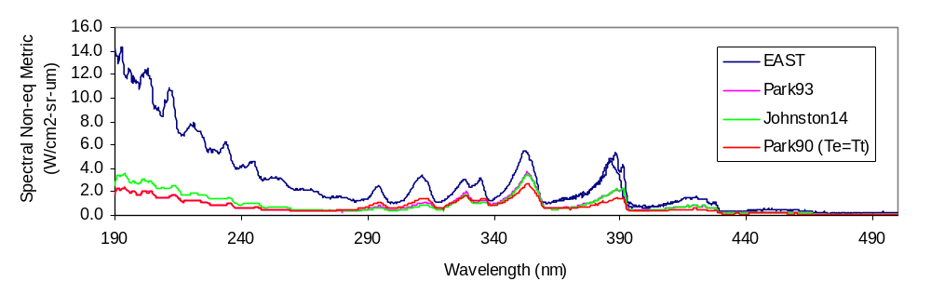
Non-equilibrium – 190-500 nm (0.70 Torr, 7.3 km/s)
10 cm tube
N₂⁺ 1st Negative
(B²Σ⁺_{u}→X²Σ⁺_{g})
NO
N₂ 2nd Positive
(C³Π→B³Π)
NO still underpredicted
N₂⁺ more underpredicted
  Heritage and newer models becoming more similar
N₂ 2nd Positive underpredicted

Slide 18
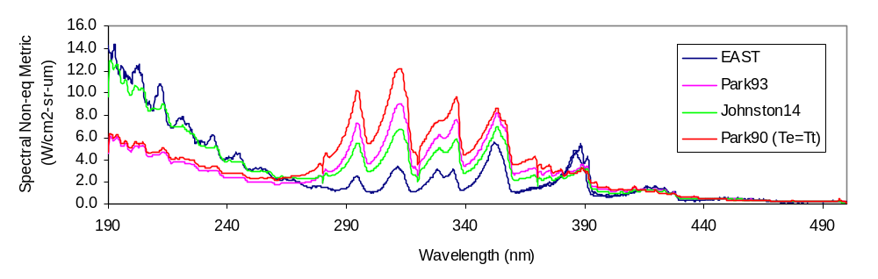
Non-equilibrium – 190-500 nm (0.70 Torr, 7.3 km/s)
10 cm tube – with Boltzmann state populations
NO
N₂ 2nd Positive
(C³Π→B³Π)
N₂⁺ 1st Negative
(B²Σ⁺_{u}→X²Σ⁺_{g})
NO matched with Boltzmann distribution for Johnston rates
N₂⁺ and N₂ are overpredicted by Boltzmann model

Slide 19
Summary 190-500 nm
NO is always underpredicted
  Speculated to be due to non-Boltzmann model
  Boltzmann simulations show Park90/93 cannot match NO intensity
    Supports higher NO recombination rate in Johnston model
N2 2nd Positive always underpredicted
  non-Boltzmann model likely needs improvement
N2+ 1st Negative underpredicted at high pressure, overpredicted at low pressure
  Could be controlling temperatures, rate model, or non-Boltzmann model

Slide 20
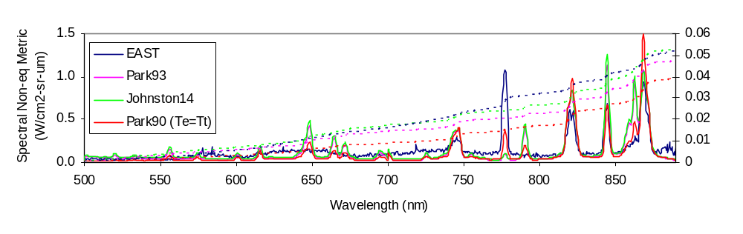
Non-equilibrium – 500-890 nm (0.01 Torr, 8.6 km/s)
60 cm tube
N₂ 1st Positive
(B³Π→A³Π)
O 3p→3s
N 3p→3s
N 4d→3p
5s→3p
O 4d→3p
5s→3p
N 4d→3p
Broad features due to N₂ 1st Positive absent from prediction
High level (4d,5s) N and O lines absent from data
O 3p : 777 underpredicted, 845 underpredicted
N 3p : overpredicted
Errors cancel out when integrated – radiance appears well matched

Slide 21
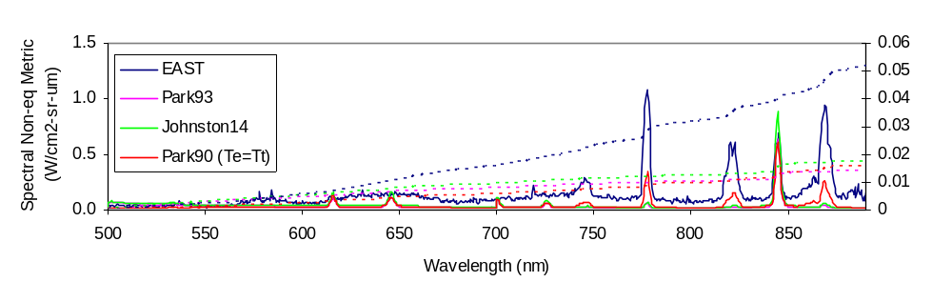
Impact of Alternate N Atom Excitation Cross-section
60 cm tube
N₂ 1st Positive
(B³Π→A³Π)
O 3p→3s
N 3p→3s
O 4d→3p
5s→3p
Huo excitation cross-sections
  Eliminate spurious radiation from N 4d, 5s
  Underpredict N 3p features

Slide 22
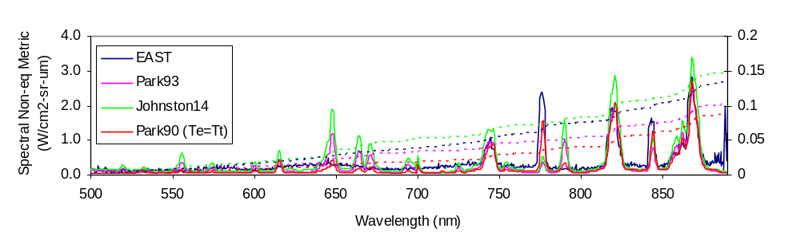
Non-equilibrium – 500-890 nm (0.05 Torr, 8.9 km/s)
60 cm tube
N₂ 1st Positive
(B³Π→A³Π)
O 3p→3s
N 3p→3s
N 4d→3p
5s→3p
O 4d→3p
5s→3p
N 4d→3p
Broad features due to N₂ 1st Positive still absent
High level (4d,5s) N and O lines still overpredicted
O 3p : underpredicted, but closer than before
N 3p : matched by Park90/Park93, overpredicted Johnston
Errors cancel out when integrated – Johnston appears to matched

Slide 23
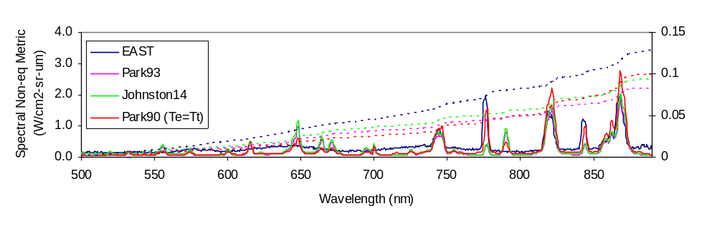
Non-equilibrium – 500-890 nm (0.14 Torr, 8.4 km/s)
60 cm tube
N₂ 1st Positive
(B³Π→A³Π)
O 3p→3s
N 3p→3s
N 4d→3p
5s→3p
O 4d→3p
5s→3p
N 4d→3p
Broad features due to N₂ 1st Positive still absent
High level (4d,5s) N and O lines still overpredicted
O 3p : matched by heritage model, underpredicted other models
N 3p : overpredicted by heritage, matched other models

Slide 24
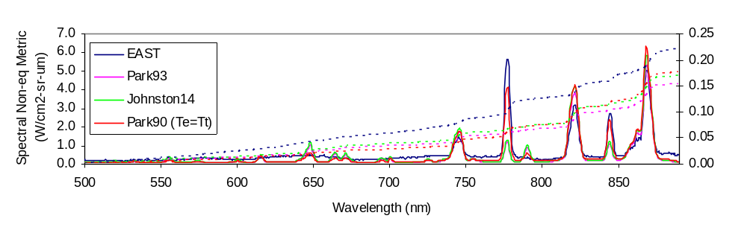
Non-equilibrium – 500-890 nm (0.14 Torr, 8.3 km/s)
10 cm tube
N₂ 1st Positive
(B³Π→A³Π)
O 3p→3s
N 3p→3s
N 4d→3p
5s→3p
O 4d→3p
5s→3p
N 4d→3p
Broad features due to N₂ 1st Positive still absent
High level (4d,5s) N and O lines overpredicted
O 3p : matched by heritage model, underpredicted other models
N 3p : overpredicted by heritage, matched other models

Slide 25
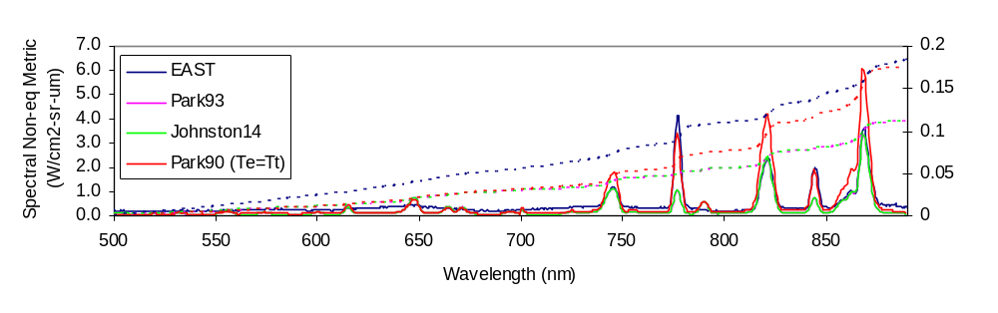
Non-equilibrium – 500-890 nm (0.30 Torr, 8.1 km/s)
10 cm tube
N₂ 1st Positive
(B³Π→A³Π)
O 3p→3s
N 3p→3s
N 4d→3p
5s→3p
O 4d→3p
5s→3p
N 4d→3p
Broad features due to N₂ 1st Positive still absent
High level (4d,5s) N and O lines overpredicted, but less significantly
O 3p : matched by heritage model, underpredicted other models
N 3p : further overpredicted by heritage, matched other models

Slide 26
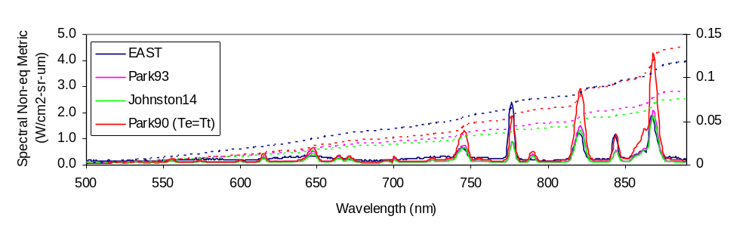
Non-equilibrium – 500-890 nm (0.50 Torr, 7.7 km/s)
10 cm tube
N₂ 1st Positive
(B³Π→A³Π)
O 3p→3s
N 3p→3s
N 4d→3p
5s→3p
O 4d→3p
5s→3p
N 4d→3p
Broad features due to N₂ 1st Positive still absent
High level (4d,5s) N and O lines overpredicted
O 3p : matched by heritage model, underpredicted other models
N 3p : overpredicted by heritage, matched other models

Slide 27
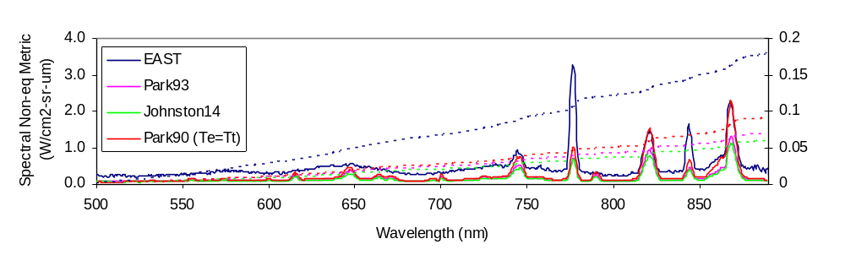
Non-equilibrium – 500-890 nm (0.70 Torr, 7.3 km/s)
10 cm tube
N₂ 1st Positive
(B³Π→A³Π)
O 3p→3s
N 3p→3s
N 4d→3p
5s→3p
O 4d→3p
5s→3p
N 4d→3p
Broad features due to N₂ 1st Positive still absent
High level (4d,5s) N and O lines overpredicted
O 3p : underpredicted all models
N 3p : overpredicted by heritage, matched other models
  Apparent disagreement due to missing underlying N₂ radiation

Slide 28
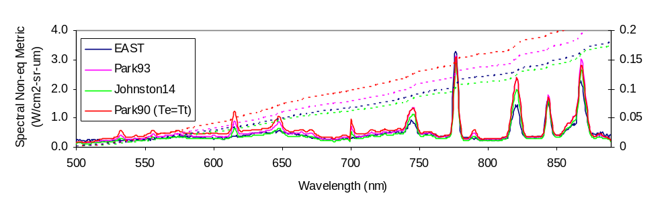
Non-equilibrium – 500-890 nm (0.70 Torr, 7.3 km/s)
10 cm tube (Boltzmann Model)
O 3p→3s
N 3p→3s
N₂ 1st Positive (B³Π→A³Π)
Boltzmann matches N₂ 1st Positive (Heritage slightly over)
High level (4d,5s) N and O lines overpredicted by Boltzmann
O 3p matched by Boltzmann (all models)
N 3p : slightly overpredicted at Boltzmann

Slide 29
Summary 500-890 nm
N₂ is always underpredicted
  Speculated to be due to non-Boltzmann model
  Boltzmann simulations match for at least one case
Atomic Lines
  Spurious N and O lines originating from 4d, 5s states
  N 3p lines
    Matched by Park90 (Te=Tt) at 0.05 Torr, overpredicted elsewhere
    Matched by Johnston at 0.14-0.7 Torr, overpredicted at lower pressure
    Matched by Park93 at 0.05-0.7 Torr, overpredicted at lower pressure
  O 3p lines
    Underpredicted by Park93/Johnston, except at 0.01 Torr
      845 nm line overpredicted at 0.01 Torr
    Heritage approach
      Nearly matches 845 nm line from 0.01-0.50 Torr
      Underpredicts 777 nm line, but not badly
    Matched with a Boltzmann distribution (0.7 Torr)

Slide 30
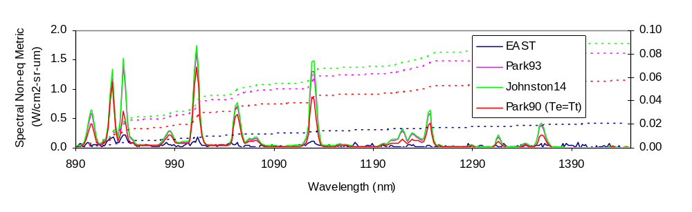
Non-equilibrium – 890-1450 nm (0.01 Torr, 8.6 km/s)
60 cm tube
N 3d→3p
O 3d→3p
N 3p→3s
N 3d→3p
N 3d→3p
N 3d→3p
N 3d→3p
O 3d→3p
N 4s→3p
N 3d→3p
O 4s→3p
N 3d→3p
N 3d→3p
All lines in this range overpredicted

Slide 31
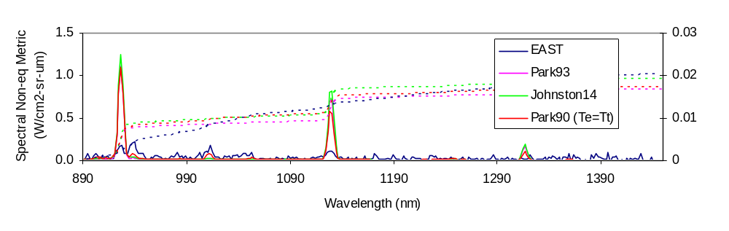
Alternate N Excitation Cross Sections
60 cm tube
N 3d→3p
O 3d→3p
N 3p→3s
N 3d→3p
N 3d→3p
N 3d→3p
N 3d→3p
O 3d→3p
N 4s→3p
N 3d→3p
O 4s→3p
N 3d→3p
N 3d→3p
Alternate cross-sections underpredict N 3p line
Other lines near noise limit
O atoms unchanged

Slide 32
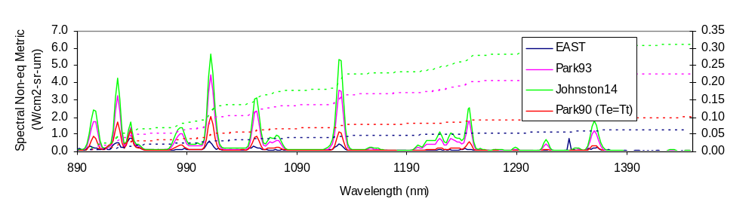
Non-equilibrium – 890-1450 nm (0.05 Torr, 8.9 km/s)
60 cm tube
N 3d→3p
O 3d→3p
N 3p→3s
N 3d→3p
N 3d→3p
N 3d→3p
N 3d→3p
O 3d→3p
N 4s→3p
N 3d→3p
O 4s→3p
N 3d→3p
N 3d→3p
Most lines overpredicted
  Park90 matches 1362 nm line
  N 3p line (939 nm) less overpredicted than others

Slide 33
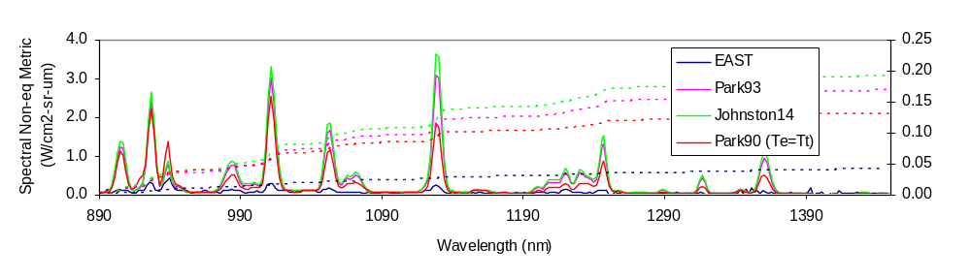
Non-equilibrium – 890-1450 nm (0.14 Torr, 8.4 km/s)
60 cm tube
N 3d→3p
O 3d→3p
N 3p→3s
N 3d→3p
N 3d→3p
N 3d→3p
N 3d→3p
O 3d→3p
N 4s→3p
N 3d→3p
O 4s→3p
N 3d→3p
N 3d→3p
All lines overpredicted

Slide 34
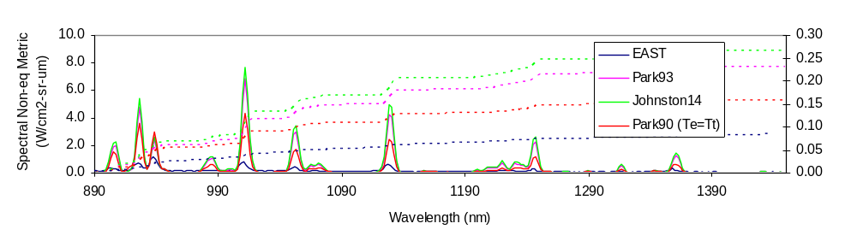
Non-equilibrium – 890-1450 nm (0.14 Torr, 8.4 km/s)
10 cm tube
N 3d→3p
O 3d→3p
N 3p→3s
N 3d→3p
N 3d→3p
N 3d→3p
N 3d→3p
O 3d→3p
N 4s→3p
N 3d→3p
O 4s→3p
N 3d→3p
N 3d→3p
All lines overpredicted

Slide 35
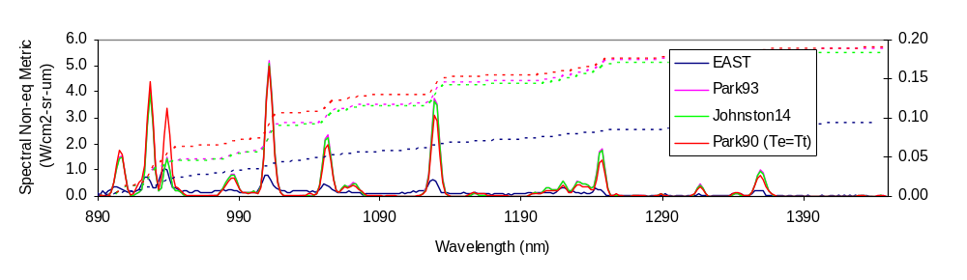
Non-equilibrium – 890-1450 nm (0.30 Torr, 8.1 km/s)
10 cm tube
N 3d→3p
O 3d→3p
N 3d→3p
N 3d→3p
O 3d→3p
N 4s→3p
N 3p→3s
N 3d→3p
N 3d→3p
N 3d→3p
O 4s→3p
N 3d→3p
N 3d→3p
All lines overpredicted
N 3p line (939 nm) near match by Park93/Johnston

Slide 36
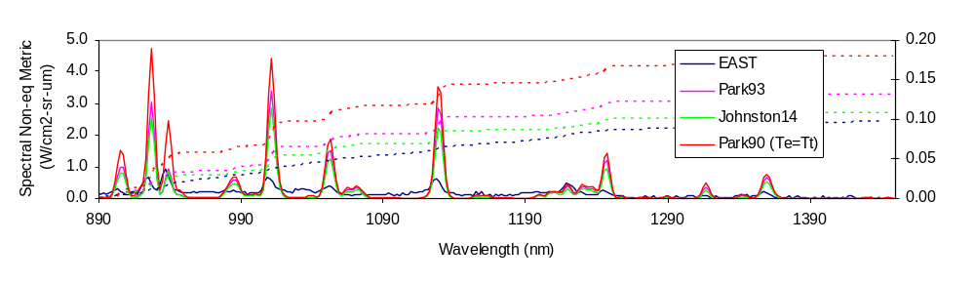
Non-equilibrium – 890-1450 nm (0.50 Torr, 7.7 km/s)
10 cm tube
N 3d→3p
O 3d→3p
N 3p→3s
N 3d→3p
N 3d→3p
N 3d→3p
O 3d→3p
N 4s→3p
N 3d→3p
N 3d→3p
O 4s→3p
N 3d→3p
N 3d→3p
Most lines overpredicted
N 3p line (939 nm) matched by Park93/Johnston

Slide 37
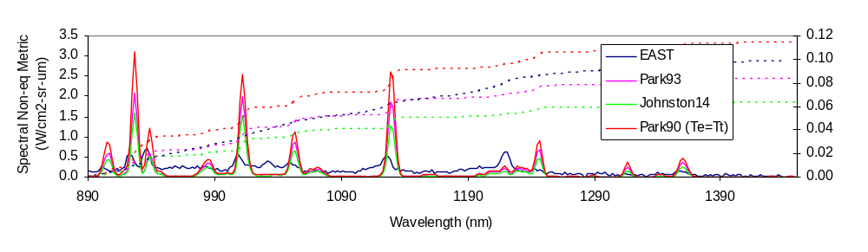
Non-equilibrium – 890-1450 nm (0.70 Torr, 7.3 km/s)
10 cm tube
N 3d→3p
O 3d→3p
N 3p→3s
N 3d→3p
N 3d→3p
N 3d→3p
O 3d→3p
N 4s→3p
N 3d→3p
N 3d→3p
O 4s→3p
N 3d→3p
N 3d→3p
Most lines overpredicted
N 3p line (939 nm) matched by Park93/Johnston
Continuum (N₂ Band) not predicted

Slide 38
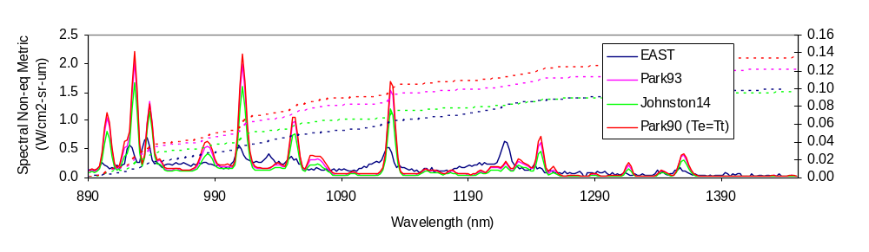
Non-equilibrium – 890-1450 nm (0.70 Torr, 7.3 km/s)
10 cm tube (Boltzmann)
N 3d→3p
O 3d→3p
N 3p→3s
N 3d→3p
N 3d→3p
N 3d→3p
O 3d→3p
N 4s→3p
N 3d→3p
N 3d→3p
O 4s→3p
N 3d→3p
N 3d→3p
Boltzmann improves background agreement, lines still too intense

Slide 39
Summary 890-1450 nm
Atomic Lines originating from higher states generally over predicted
One N 3p line is matched well by Park/Johnston from 0.3-0.7 Torr
Molecular radiation at 0.7 Torr mostly matched under Boltzmann

Slide 40
Summary
Non-equilibrium Radiation Data Presented from 7-9 km/s at 6 freestream pressures from 0.01-0.70 Torr
Agreement to Predictive (DPLR/NEQAIR) Model is mixed
  Molecular radiation from N₂/NO is underpredicted
    Boltzmann distribution takes up underprediction for N₂ B state and NO radiation
    N₂ C state is overpredicted by Boltzmann
  N₂⁺ radiation prediction varies with pressure
    At low pressure: overpredicted for T_{e}=T_{v}, matched by heritage model
    Reasonably matched for intermediate pressure range
    Underpedicted at high pressure
  High lying N, O state radiation overpredicted
  Radiation from 3p states of N predicted well, except at lowest pressure
  Radiation from 3p states of O mostly underpredicted
How does your model do?
  https://data.nasa.gov/docs/datasets/aerothermodynamics/EAST/index.html
  (Test 59 - available soon)

Slide 41
Backup

Slide 42
Spectral Non-equilibrium Metric
190-280 nm
NO
280-320 nm N₂
320-370 nm N₂/N₂⁺
700-900nm
N, O
3p-3s
900-1450nm
N, O
3d-3s
370-500 nm N₂⁺
500-700nm
N₂
Identification of features suggests regions for further analysis

Slide 43
Reaction Rates
There are between up to 23 reactions rates across the 3 models, 11 of which have some differences:
    NO + M ↔ N + O + M increased by Johnston
    N₂ + O ↔ NO + N Johnston used rate from Fujita, 2006
    NO + O ↔ O₂ + N Johnston uses rate from Bose, 1997
    N + O ↔ NO⁺ + e⁻ Updated Park93, Johnston/Park90 same
    N + N ↔ N₂⁺ + e Updated Park93, Johnston/Park93 same
    O + O ↔ O₂⁺ + e Updated Park93, Johnston/Park93 same
    O⁺ + NO ↔ N⁺ + O₂ Activation energies differ
    N⁺ + N₂ ↔ N₂⁺ + N Missing from Park90, Johnston/Park93 same
    O₂⁺ + O ↔ O⁺ + O₂ Missing from Park90*, Johnston/Park93 same
    N₂ + e ↔ N + N + e Differs across all three chemistries
    O₂ + e ↔ O₂⁺ + e Missing from Park90/Park93
These rates not important
* As implemented in DPLR

